Slide 1
Hub for Health Intervention, Policy and Practice
Ayako Miyashita Ochoa, JD
she/her/hers
amochoa@luskin.ucla.edu

Slide 2
Introducing UCLA HHIPP
The UCLA Hub for Health Intervention, Policy and Practice (HHIPP) connects the academy, community and policy makers to address health disparities among diverse communities in Los Angeles and beyond.
The Hub engages community members in meaningful, impactful, theory-driven, and sustainable research that informs high-level policy and street-level social justice health outcomes.
UCLA HHIPP’s work situates health policy within a social welfare and social justice framework.

Slide 3
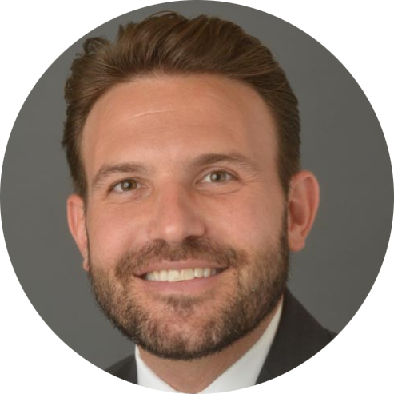
UCLA HHIPP Co-Directors
Ian Holloway, PhD, LCSW, MPH
Professor
Ayako Miyashita Ochoa, JD
Adjunct Professor
(he/him/his)
(she/her/hers)

Slide 4
Mission: Co-create research that informs policy and practice and addresses intersecting oppressions to improve community health
01
02
03
Responsive Research Initiatives
Community-Led Research Collaboration
Building Capacity for Evidence-Based Policymaking

Slide 5
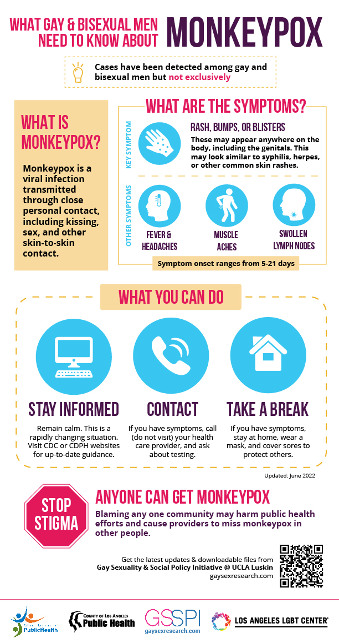
STICKITIN.LA
Develop and disseminate harm reduction materials for gay and bisexual men in multiple languages for ongoing mpox outbreak
Mpox modeling with LADPH and USC collaborators
Community education and outreach alongside mpox vaccination efforts

Slide 6
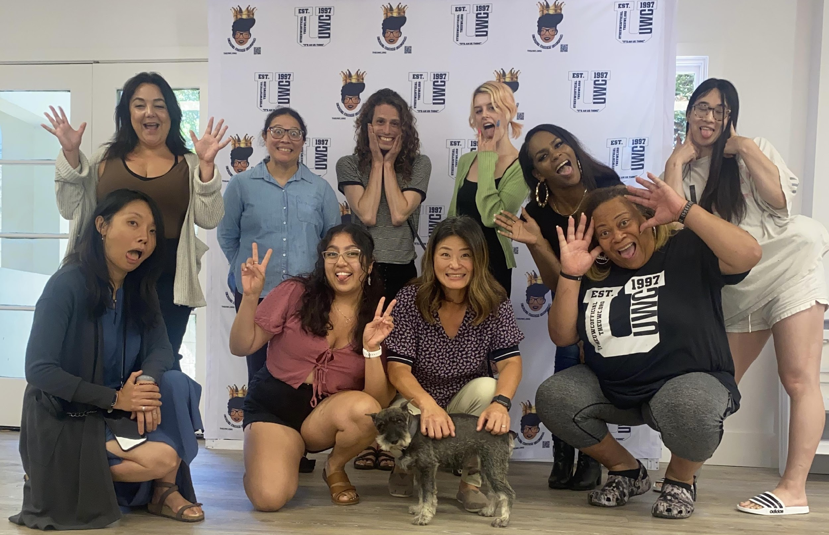
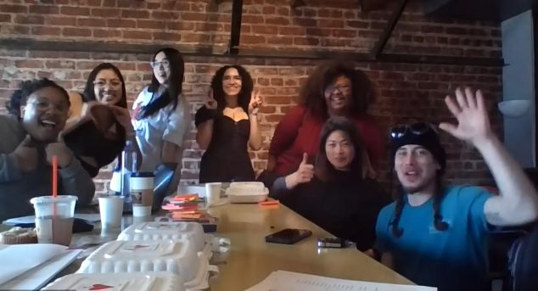
Sex Work LEARN (Lived Experience Affirming Research Network)
Funded by the California HIV Research Program, UCOP, SW LEARN will establish a research agenda for sex workers by sex workers and develop an HIV status neutral intervention focusing on the needs of transgender women with sex work experience who identify as Black, indigenous or other persons of color.

Slide 7
Primary Partners

Slide 8
Sex Work LEARN Collaborative
Trans-led community based agencies
Academic institutions
LAC Department of Public Health
Community-rooted advisors

Slide 9
Southern California HIV/AIDS Policy Research Center
Disseminate on website & social media
SCHPRC focus areas
Community Surveys and Consultations
Publish findings as policy briefs & infographics
RAPID RESPONSE RESEARCH
Community Surveys and Consultations
Data Analysis
Rapid response research
Results used to inform prioritization of rapid response research
Disseminate on website & social media
Funded by the California HIV/AIDS Research Program (H21PC3466)

Slide 10
Research Products
Policy Briefs
Manuscripts
Infographics
Are California pharmacists ready to provide long-acting injectable PrEP for HIV Prevention?
Risk of Criminalization among Sex Workers Carrying Condoms
Insights from Drug Checking Programs: Practicing Bootstrap Public Health Whilst Tailoring to Local Drug User Needs
Zero-Cost Preventive Care for Californians & Extended Coverage for STI Screenings
Comparison of Approaches to Linkage to Post-Release Care Between Community Medical, Behavioral Health, and Re-entry Service Providers
Proceedings
Inland Empire SCHPRC Convening
End the Epidemics Strategy Meeting Proceedings
Fact Sheets
New California Guidance for PrEP Coverage
Contingency Management
Data Visualizations
Lens Mapping Tool
Transgender People and HIV in California

Slide 11
Today’s Programming
LEARNING OBJECTIVES
Defining law and policy tools
Understanding how research fits into the policymaking process
Connecting with movement leaders
Framing research results for successful dissemination
Developing research products that speak to the communities you serve
Achieving strategic alignment and mutuality with the communities you serve

Slide 12
Today’s Programming
TRANSLATING HIV RESEARCH FINDINGS FOR MAXIMUM POLICY IMPACT
A single perspective shared in 3 parts:
What you need to know before you get started with research
What you should know about law and policy implementation
What you can do to frame your research for successful dissemination

Slide 13
Poll #1: ADVOCACY

Slide 14
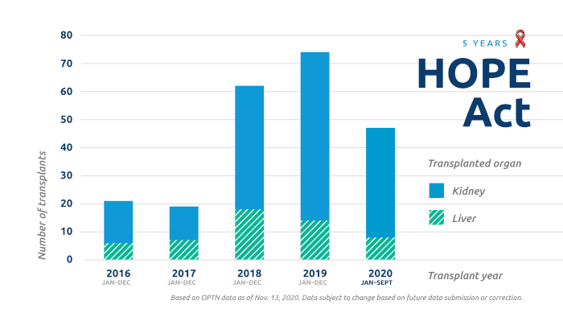
A. Need to Know
CONNECTING WITH MOVEMENT LEADERS
HIV Criminalization
Organizational advocacy
Administrative advocacy
Legislative advocacy
Litigation
Other
Guevara v. Superior Court, 62 Cal. App. 4th 864, 871-74 (1998)

Slide 15
A. Need to Know
DETERMINING IF THE RESEARCH QUESTION IS POLICY RELEVANT
Criminalization of Sex Work

Slide 16
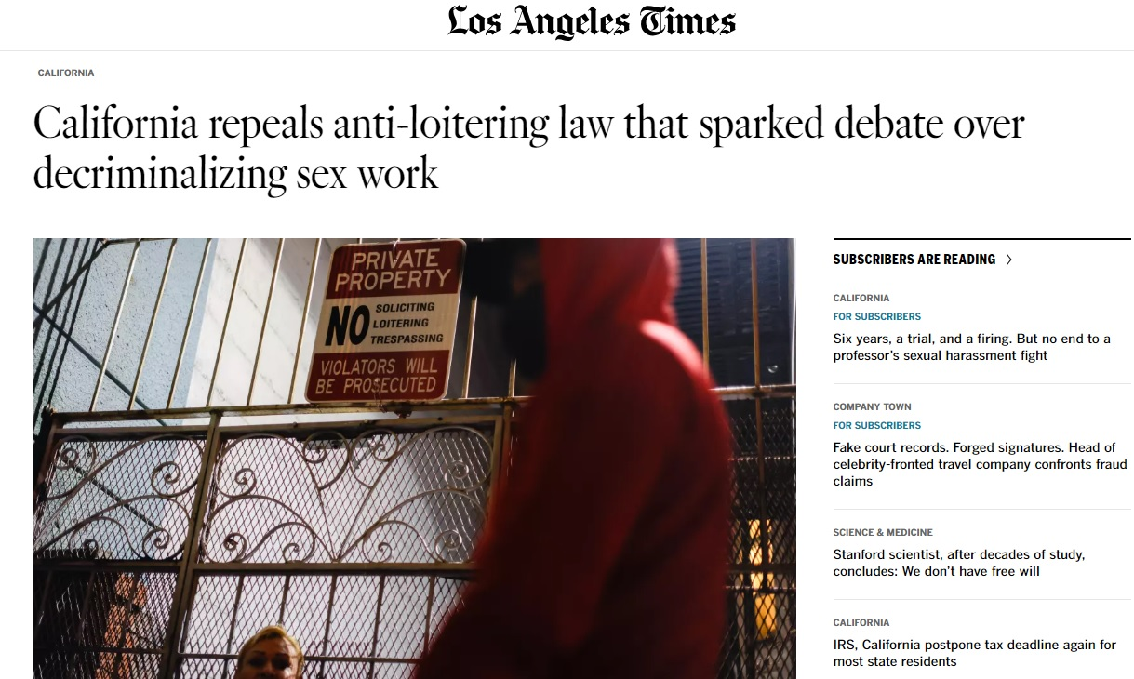
A. Need to Know
IDENTIFY HOW RESEARCH MIGHT PROVIDE INSIGHT NEEDED
Policing and Harassment of BIPOC Transgender Sex Workers
DECRIMSEXWORKCA

Slide 17
A. Need to Know
KEY CONSIDERATIONS
Center lived experiences
Identify who is missing from the conversations you’re having or listening in on
Invest time in understanding the research needs of advocates
Re-evaluate your framing of what is novel or innovative to focus on what is needed by the communities you serve

Slide 18
Poll #2: LAW & POLICY

Slide 19
B. Should Know
THREE BRANCHES OF GOVERNMENT
LEGISLATIVE
Makes laws
EXECUTIVE
Carries out laws
JUDICIAL
Evaluates laws

Slide 20
B. Should Know
SOURCES OF LAW
F
Regulations
Guidance and policies
Federal Law
U.S. Constitution
Federal statutes
Federal case law
S
Regulations
Guidance and policies
State Law
State Constitution
State statutes
State case law
L
Local Law
Local law, regulations, ordinances
Relevant guidance and policies

Slide 21
B. Should Know
POLICY AND LAW AND WHEN THEY INTERSECT
Policy
Law
“A law is an established procedure, standard, or system of rules that members of a society must follow. A policy is a decision or set of decisions meant to address a long-term purpose or problem.”
Teitelbaum, J. et. al. (2021)

Slide 22
B. Should Know
SOME GUIDING PRINCIPLES
U.S. Constitution reigns supreme
U.S. Supreme Court is the last authority on matters related to the U.S. Constitution
Federal laws can create “floors” and “ceilings”
States can choose to enact more robust laws, but sometimes there is conflict
Determining who (which level/actor of government) has the power to decide can resolve conflicts

Slide 23
B. Should Know
WHERE RESEARCH FITS
Identifying problems in implementation
Informing policy solutions
Expert testimony
Amicus Briefs
Executive Branch
Judiciary
For the People
Organization
Informing affected communities
Informing advocated and service providers
Informing the general public
Informing evidence-based programming
Legislature
Informing bill proposals
Informing the legislature
Informing advocates

Slide 24
C. Can Do
MAKE CONNECTIONS
End the Epidemics statewide coalition
Join the UCLA CHIPTS Policy Impact Core
Join listserv for California HIV/AIDS Policy Research Centers

Slide 25
C. Can Do
Slide courtesy of Katja Nelson, APLA Health

Slide 26
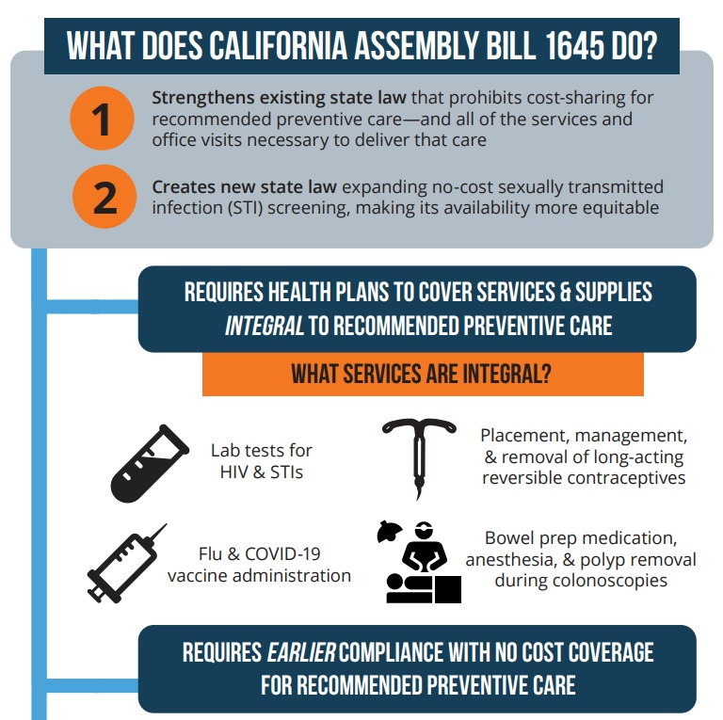
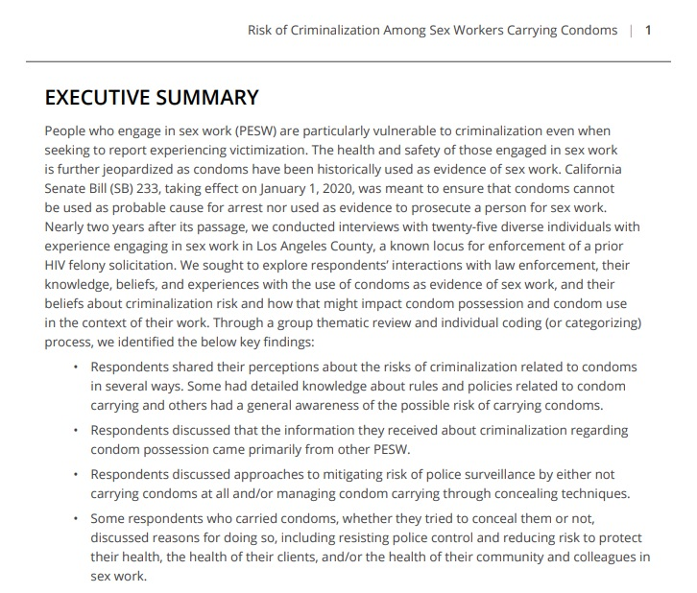
C. Can Do
KEY CONSIDERATIONS
Who are your partners and how are you strategically aligned?
Who are you targeting as your audience?
What research products will reach your intended audience?

Slide 27
Thank you!
@uclahhipp
@uclahhipp
UCLAHHIPP.com

