Slide 1
UCLA-CDU CFAR Clinical Science Core
Clinical Discovery Seminar
Pregnancy, HIV/Hepatitis B, and the IMPAACT Network: leveraging clinical trial repositories to answer key questions for persons living with HIV and HBV
Debika Bhattacharya, MD, MSc
Clinical Professor, Division of Infectious Diseases
Associate Director, ID Fellowship Training Program
University of California Los Angeles
Co-Director, NODES Program, VAGLAHS
Co-Director, Viral Hepatitis Program, VAGLAHS
Heather Sprenger, MS
Laboratory Data Division Chief
Frontier Science Foundation

Slide 2
Clinical Discovery Seminar Objectives
Create a community of clinical, behavioral, and translational HIV researchers at UCLA and CDU and beyond
Share innovative work by CFAR investigators utilizing NIH and other funded data and sample repositories
Introduce investigators to opportunities to propose new work/projects using existing data and sample repositories
Stimulate new ideas and collaboration
Support investigators in proposing analyses to these cohorts
UCLA-CDU CFAR grant P30 AI152501

Slide 3
Upcoming Clinical Science Core Events
Thursday, January 11, 2024, Clinical Discovery Seminar (11:00 am-12:00 pm via Zoom)
“uTECH- using technology to find substance use and sexual partners”, presentation by Ian Holloway, PhD, LCSW
Register here:
To access past seminars/workshops and learn about future events, please visit our website: https://cfar.ucla-cdu.org/cores/clinical-science-core/
Core Contact Information:
Core Director – Kara Chew, MD, MS
Core Program Manager – Stephanie Buchbinder, MPH
Core email: cfarclinicalcore@mednet.ucla.edu

Slide 4
Pregnancy, HIV/Hepatitis B and the IMPAACT Network: Leveraging clinical trial repositories to answer key questions for persons living with HIV and HBV
Debika Bhattacharya MD MSc
Clinical Professor of Medicine
University of California at Los Angeles (UCLA)

Slide 5
Disclosures
Gilead Sciences- Investigator-Initiated Grant, Grant Paid to the Institution

Slide 6
Objectives
Overview of the IMPAACT Network and its Studies
The Process: Requesting Samples and Data
Common Challenges/Solutions
Case Studies: HBV Clinical Outcomes in HPTN 046 and PROMISE studies

Slide 7
Research Qs as a New Faculty Member
Little is known about HBV in PLH, particularly in pregnancy
HBV not routinely screened for in LMIC
cART contains HBV-active therapy
What is the impact of HBV on pregnancy and infant outcomes in PLH?
What is the impact of various ARV regimens and strategies on pregnant women?
What is the most efficient and fundable way that I can answer these questions?

Slide 8
Why use clinical trial repositories for HIV research?
Multi-site, international clinical trials with diverse participants
Opportunity to collaborate with/ be mentored by experts in the field
Ability to study populations of interest across regions, exposures
Data quality and standardization
Many scientific questions not yet assessed
Expeditious Results (relative to conducting a clinical trial)
Skip time consuming and costly initial phases of research
Access to funding opportunities
Many funders (NIH, pharma) interested in funding this research, leveraging costs/infrastructure they have already built
Samples are there !! and may be thrown away if unused

Slide 9
Why study pregnancy and its related outcomes in HIV?
Intersection of comorbid conditions, HIV, and pregnancy often unrecognized
01
Unique immunologic milieu in pregnancy that may impact co-infection outcomes
02
Unique physiologic state impacts drug concentrations and potential for adverse events
03
Importance of including pregnant women and their infants/children- often understudied
04
Evaluation of perinatal transmission of other coinfections
05

Slide 10
HIV/AIDS Clinical Trials Networks
AIDS Clinical Trials Group (ACTG)
HIV Prevention Trials Network (HPTN)
HIV Vaccine Trials Network (HVTN)
International Maternal Pediatric Adolescent AIDS Clinical Trials (IMPAACT)
Microbicide Trials Network (MTN)

Slide 11
Why IMPAACT? Clinical trials in PLH who are pregnant and their infants, children

Slide 12
Why IMPAACT? Diverse Site Locations

Slide 13
Research Areas: 25 Enrolling Studies
Tuberculosis
HIV Cure
HIV Treatment
Complications

Slide 14
IMPAACT Website: HIV Treatment
https://www.impaactnetwork.org/about/areas-research/hiv-treatment

Slide 15
The Process: Nuts and Bolts
Contact study chair/co-chair/ team member- discuss ideas
Ask for permission for protocol document
Review objectives (secondary, exploratory)
Review schedule of events
What was collected (plasma, serum, PBMCs, tissue) etc
When was it collected?
How much was collected
Review website for serum repositories
Submit NWCS, DACS, or DR
Obtain funding
If using samples, negotiate MTAs

Slide 16
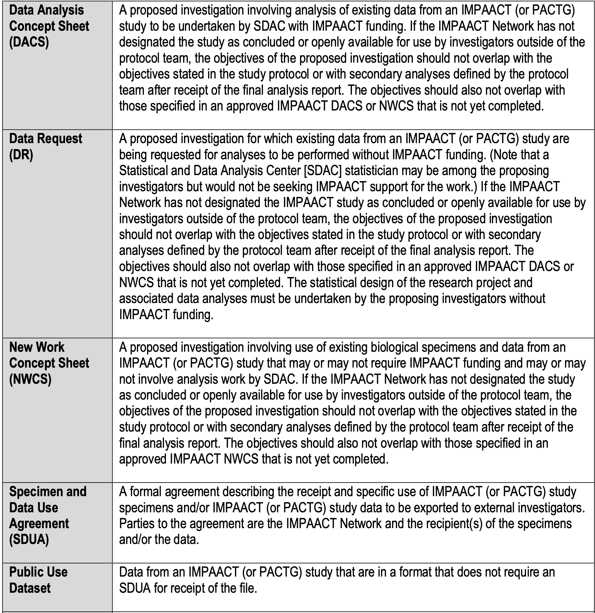
impaact.capsubmissions@fstrf.org
https://www.impaactnetwork.org/sites/default/files/2021-01/FINAL_15_Ancillary_V3.0_20JAN2021.pdf

Slide 17
IMPAACT Biorepositories
Heather Sprenger
IMPAACT Data Management Center
November 2, 2023

Slide 18
IMPAACT Biorepositories
IMPAACT Repository Biomedical Research Institute 9410 Key West Avenue, First Floor Rockville, MD 20850
NICHD Repository Fisher Bioservices 625 Lofstrand Lane Rockville, MD 20850

Slide 19
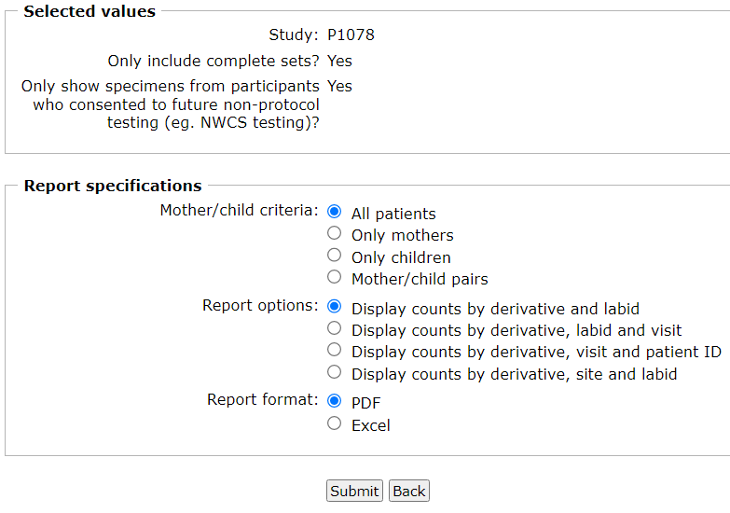
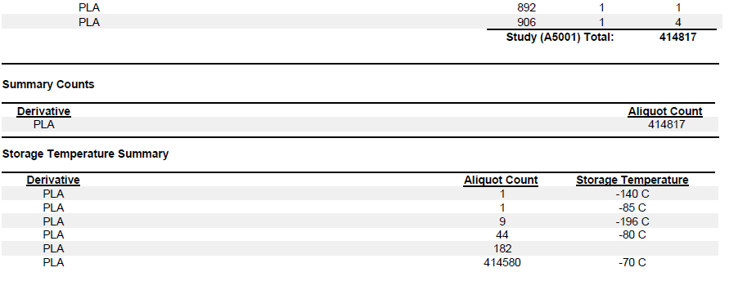
Specimen Inventory Report
Available to IMPAACT Investigators only
Available on the Frontier Science Portal at www.frontierscience.org/portal
Request account at www.frontierscience.org/register
High level inventory summary
All studies (including active ones)
Specimens located at sites and repositories are included

Slide 20
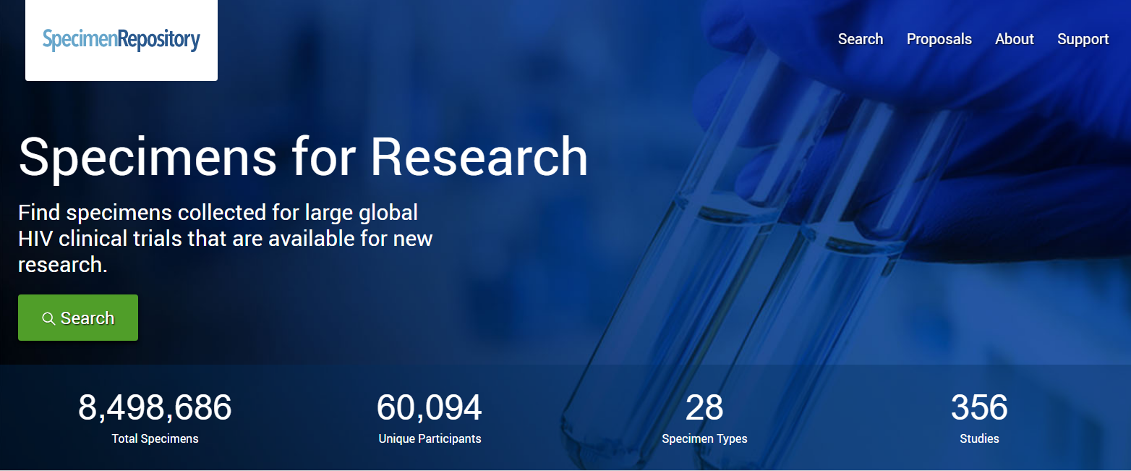
Specimen Repository Website
Public website, no login required: www.specimenrepository.org

Slide 21
Specimen Repository Website
Approved Concluded & POS/PAC studies
Networks: ACTG, IMPAACT, HVTN
Only includes specimens with consent for future testing
Biorepositories only
Graphical interface
Data visualizations

Slide 22
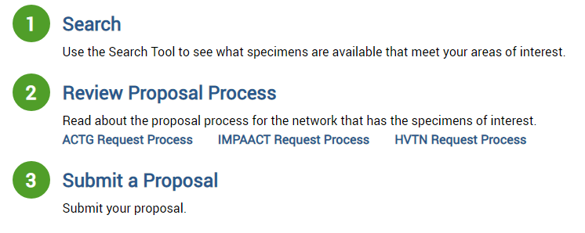
Specimen Repository Website - steps

Slide 23
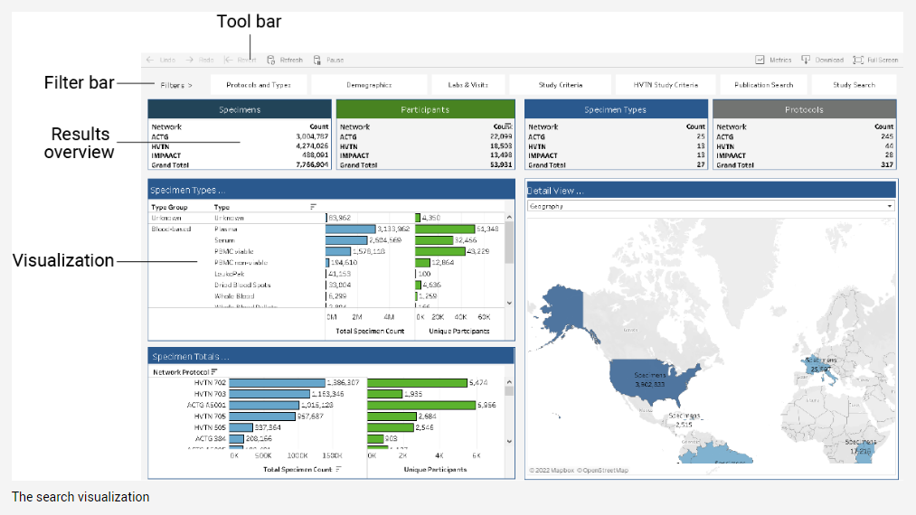
Specimen Repository Website - searching
Overview

Slide 24
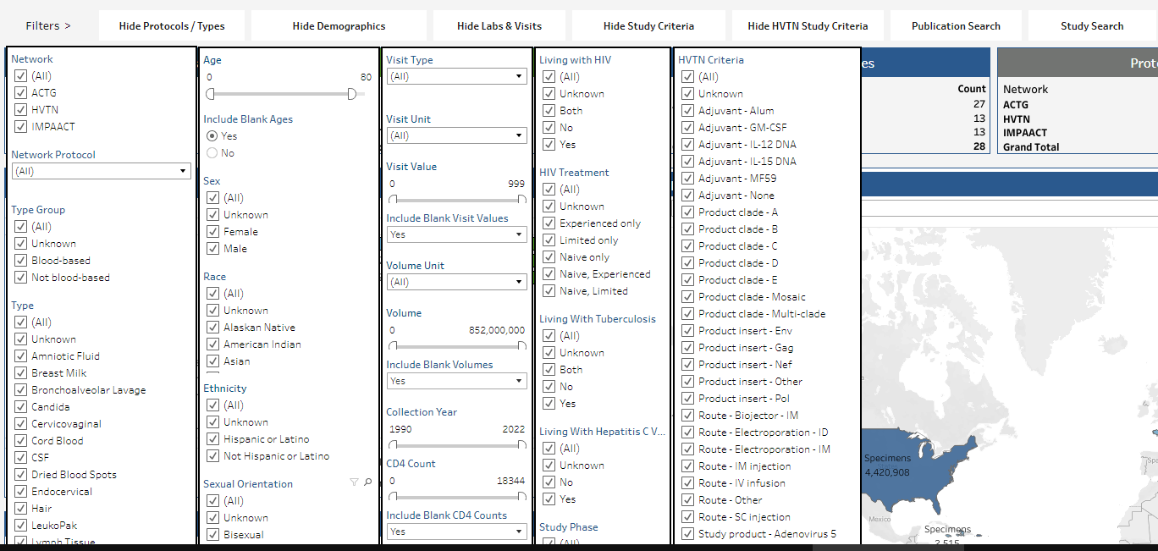
Specimen Repository Website - searching
Filtering

Slide 25
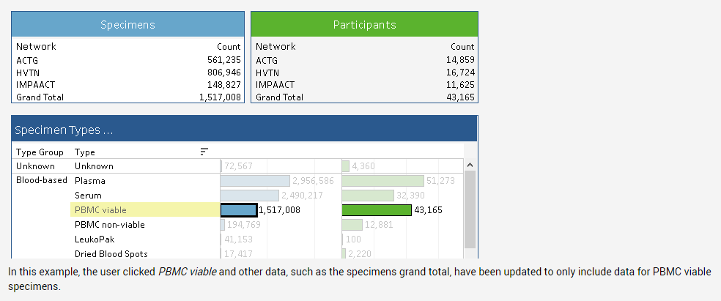
Specimen Repository Website - searching
Interacting with the search visualization
Notes:
The initial state of the search visualization displays all specimen and participant counts without any filtering applied.
Click on any data item in the visualization to filter by that item. For example, in the Specimen Types pane, click PBMC viable to filter all data by that specimen type. All data in the search visualization would now only show data for PBMC viable specimens (e.g. the list of Specimen Totals by Network Protocol now only includes PBMC viable specimens).
(Note: The ... in the title bar of a section of the visualization indicates that you can filter by clicking a data item in that section.)

Slide 26
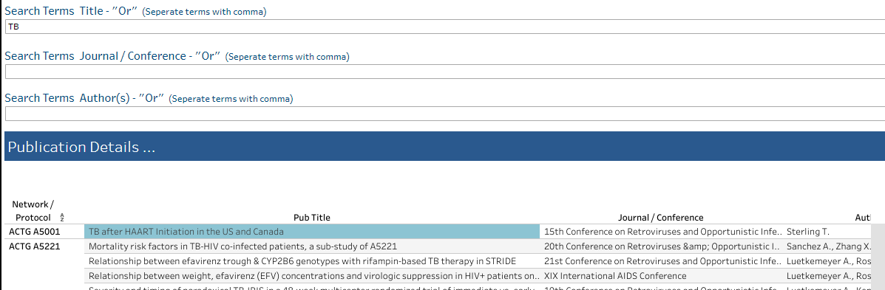
Specimen Repository Website - searching
Publication search

Slide 27
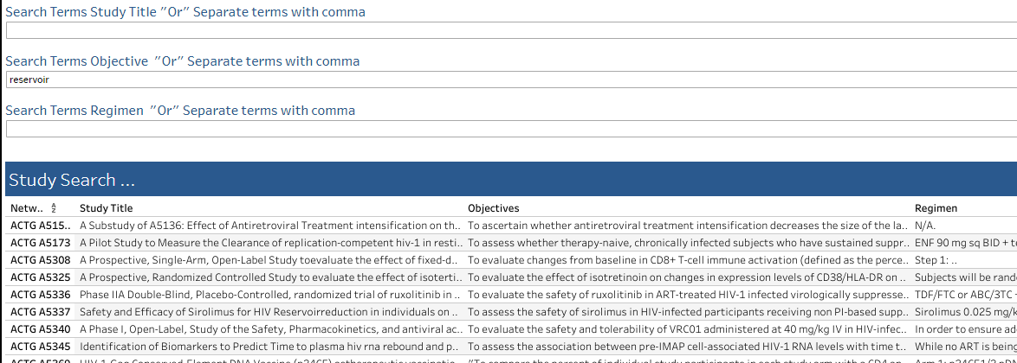
Specimen Repository Website - results
Study Search

Slide 28
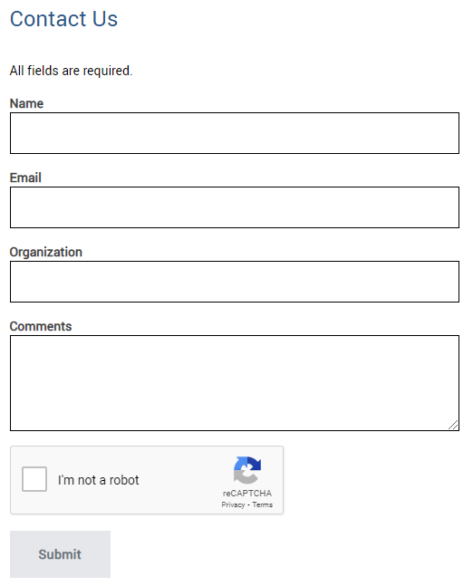
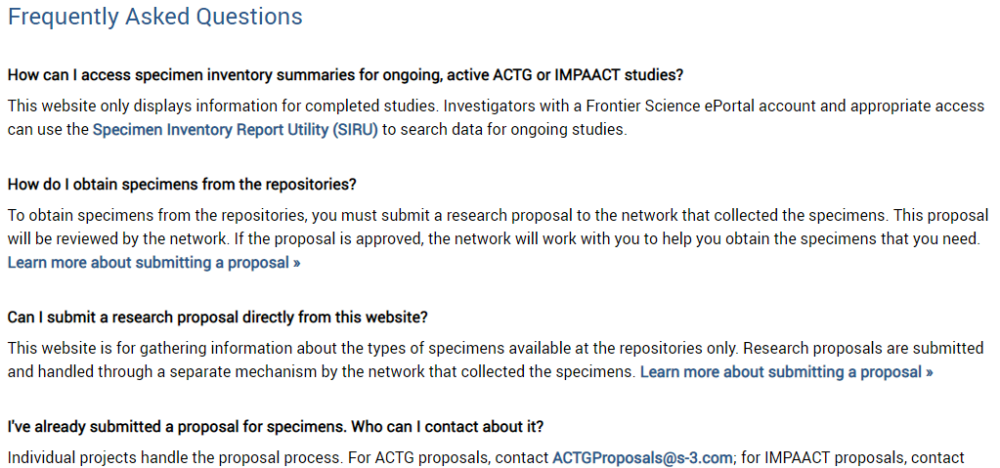
Specimen Repository Website – support
Click Support Frequently Asked Questions
Fill out the Contact Us form and a DMC staff member will be on touch

Slide 29
Submit a NWCS Proposal
Investigations using biological specimens from completed IMPAACT studies should be proposed via a New Works Concept Sheet (NWCS), which is accessible here: New Works Concept Sheet (NWCS).
Completed NWCSs should be submitted to the IMPAACT Operations Center for review by the IMPAACT network using this email address: impaact.capsubmissions@fstrf.org.

Slide 30
NWCS procedures
Information on the NWCS submission and review processes is available in Section 15 of the network Manual of Procedures here.
Specimen Data Use Agreement, IRB approval/waiver
International sites may require Material Transfer Agreements

Slide 32
Common Challenges/Solutions
Lack of funding
*great* concept proposals for pilot awards (CFAR!!), K23, R21, even R01
Lack of testing for disease of interest
Consider restricting to smaller subset of participants
Obtain funding for testing
Sometimes exclusion criteria for clinical trials
Age of cohorts
Acknowledge in grants/MS
Identify relevant questions (pre-COVID, ART strategies that are now relevant again)
Review sample storage and timeline requirements for assays of interest
MTAs
Identify end testing laboratory
Work with laboratory/ logistics personnel
Provide funding in grant
The Unknowns!!!
Government shutdown, across the board budget cuts, not all funding granted
Freezer died, some samples lost

Slide 33
Case Studies

Slide 34
Background- Epidemiology of HBeAg and HBV VL in pregnant PLWH in SSA
HBV Coinfection is Common in Pregnant Women Living with HIV (PWLWH), 3-12%¹⁻⁵
WHO recommends screening for HBeAg, HBV VL, and also recommends HBV rx in pregnancy but little data in PWLWH and HBV⁶
Is there a difference in HBsAg and HBeAg prevalence b/w various countries in HIV infection?
Maternal HBV Viremia is Important for Perinatal and Maternal Long Term Outcomes and in HBV Monoinfection, HBe-agemia predictive of elevated HBV VL
What are the predictors of elevated HBV VLs?
Is HBeAg predictive of HBV VL in pregnant women living with HIV?
1) Fomulu BMC Preg Childbirth 2013. 2) Rouet J Med Virol 2004. 3) Chasela J Hepatol 2014. 4) Andersson Vaccine 2013. 5) Bayo P BMJ Open 2014 6) WHO Guidelines Prevention of MTCT of HBV 2020.
Notes:
Neaka-
please insert refs from PROMISE posters re: 3-12%
Please insert refs for WHO Suggested citation. Prevention of mother-to-child transmission of hepatitis B virus: guidelines on antiviral prophylaxis in pregnancy. Geneva: World Health Organization; 2020. Licence: CC BY-NC-SA 3.0 IGO.

Slide 35
Objectives and Methods
To characterize the prevalence and predictors of HBV infection (defined by HBsAg positivity) in the HPTN 046 cohort.
Among those with HIV/HBV, to characterize the prevalence and predictors of HBeAg status, high HBV VL (defined as HBV VL > 10⁶ IU/ml), and maternal HBV viremia at delivery in the HPTN 046 cohort.
Post-hoc Analysis of HPTN 046 Cohort

Slide 36
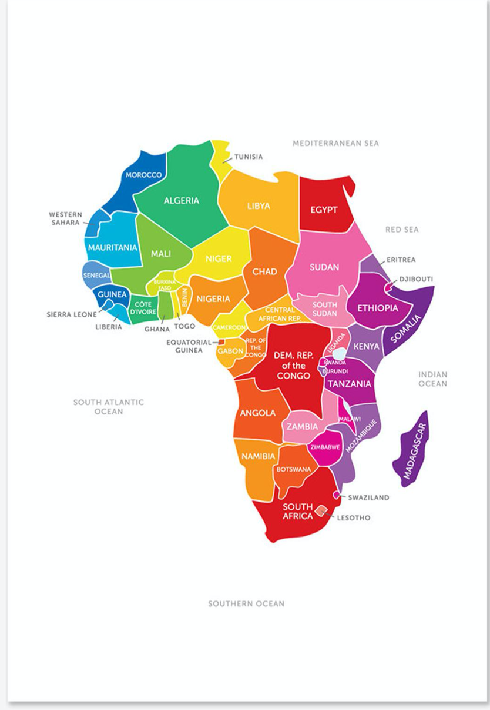
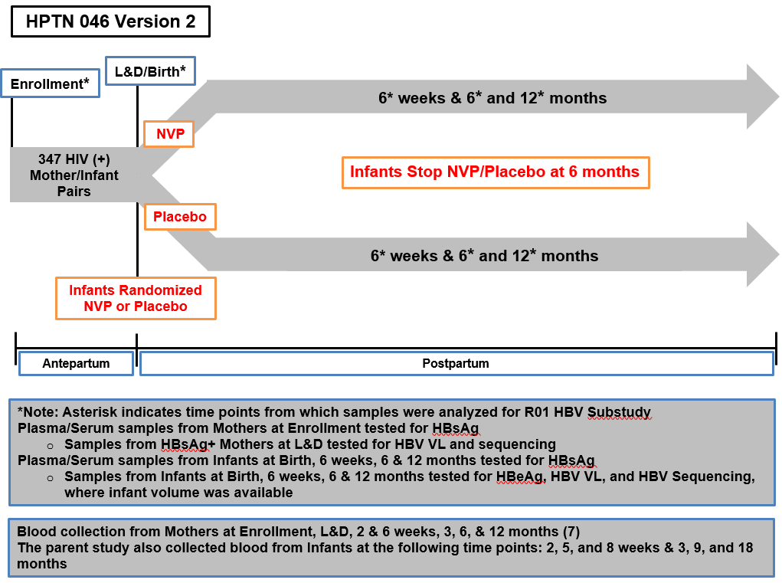

Slide 37
Maternal Baseline Analysis
HBV Perinatal Transmission
Infant Outcomes
Infant Vaccine Response

Slide 38
Methods: Statistical Analysis
Summary statistics of maternal and infant demographic and clinical information at baseline were reported to characterize the study cohort by maternal HBV status and to identify potential confounders
Performed bivariate and multivariable analyses to assess the association of the following with HBV status (defined as HBsAg positivity) and its sub-categories (defined by HBeAg or HBV VL status)
Maternal demographics
HIV characteristics
HBV characteristics
Bivariate and multivariable analyses were performed among all mothers and mothers with HIV/HBV coinfection
To compare continuous variables between maternal HBV status and its sub categories, Kruskal-Wallis or Wilcoxon rank sum test was used, and to compare categorical variables, chi-square or Fisher’s exact test was utilized.
Multivariable logistic regression analyses were also preformed to evaluate the predictors of maternal HBV status and its sub-categories (HBeAg or HBV VL status) among HIV infected pregnant women
Complete case data analysis was performed, no multiple comparison adjustment was made and P-values < 0.05 were considered statistically significant. All analysis were performed using SAS v9.4 (SAS Institute Inc., Cary, NC).
Notes:
Chi Hong and Rong to add

Slide 39
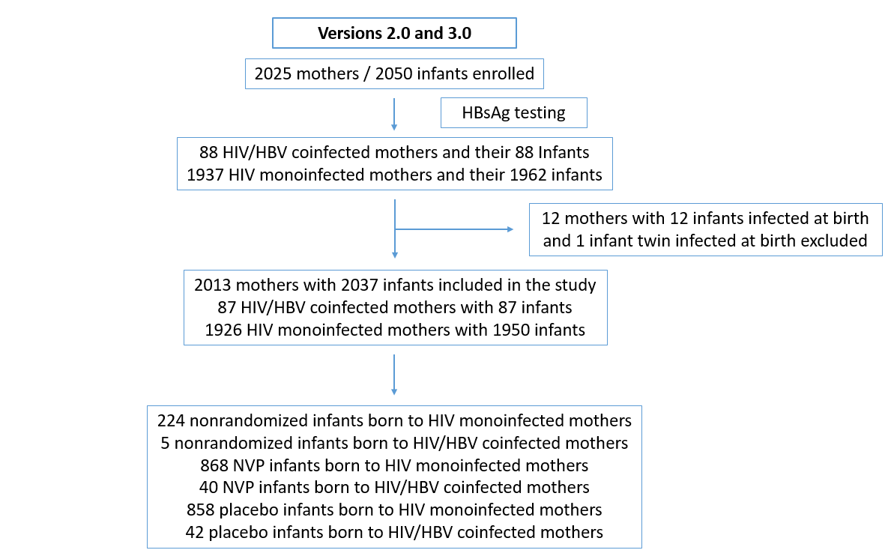
Consort Diagram v 2.0 and 3.0

Slide 40
Baseline HIV/HBV Demographic Distributions By Country– Combined v2.0 & v3.0-All Participants
Variable |  | HIV Monoinfected | HIV HBV Coinfected | All Participants | p Value
Country | Uganda | 710(97) | 23(3) | 733 | <0.01
 | Zimbabwe | 641(98) | 16(2) | 657
 | Tanzania | 199(91) | 19(9) | 218
 | South Africa | 378(93) | 30(7) | 408
Geographic Variation By Country in HBsAg Prevalence

Slide 41
Distribution of Study Participants by Country (Regardless of ART)
Geographic Variation By Country in HBeAg Prevalence
Notes:
Neaka- pls see above request on slide

Slide 42
Baseline HIV/HBV Demographics – Combined v2.0 & v3.0-All Participants
Variable |  | HIV Monoinfected | HIV HBV Coinfected | All Participants | p Value
Country | Uganda | 710(37) | 23(26) | 733 | <0.01
 | Zimbabwe | 641(33) | 16(18) | 657
 | Tanzania | 199(10) | 19(22) | 218
 | South Africa | 378(20) | 30(34) | 408
Median Age |  | 27(23-31, N=1928) | 28(24-32, N=87) | 27(23-31, N=2015) | 0.14
Median CD4* (cells/mm³) |  | 490(329-698, N=1925) | 417.5(262-582, N=88) | 488(326-695, N=2013) | <0.01
ART during Pregnancy | N | 426(22) | 11(13) | 437 | 0.03
 | Y | 1502(78) | 77(88) | 1579
ART within 7 days prior to delivery |  |  |  |  | 0.04**
None |  | 457(24) | 11(13) | 468
ART |  | 1471(76) | 77(88) | 1548
 | Non-HBV Active | 683(46) | 37(48) | 720
 | HBV Active | 788(54) | 40(52) | 828
Median Duration of ART within 7 days prior to delivery |  | 61(40-85, N=1471) | 77(48-104, N=77) | 61(40-86, N=1548) | 0.01
HBV Active ART Duration within 7 days prior to delivery |  | 61(34-152, N=787) | 85(30-387, N=40) | 61(34-160, N=827) | 0.32
Amongst HIV/HBV→ Lower Median CD4, higher likelihood of ART, longer duration of ART

Slide 43
Characterization and Predictors of Maternal High HBV VL at Delivery
Variable |  | HBV VL <10⁶ IU/ml | HBV VL ≥10⁶ IU/ml | All HIV HBV | p Value
Country | Uganda | 18(23) | 5(50) | 23 | 0.42
 | Zimbabwe | 15(19) | 1(10) | 16
 | Tanzania | 18(23) | 1(10) | 19
 | South Africa | 27(35) | 3(30) | 30
Median Age |  | 27(23-32, N=77) | 28.5(27-32, N=10) | 28(24-32, N=87) | 0.47
Median CD4* (cells/mm³) |  | 433.5(263-609, N=78) | 319.5(210-454, N=10) | 417.5(262-582, N=88) | 0.22
HBeAg | Neg | 65(83) | 1(10) | 66 | <0.01
 | Pos | 13(17) | 9(90) | 22
ART during Pregnancy | N | 9(12) | 2(20) | 11 | 0.61
 | Y | 69(88) | 8(80) | 77
Median Duration of ART within 7 days prior to delivery |  | 69(43 -99, N=69) | 93.5(71.5-1236.5, N=8) | 77(48-104, N=77) | 0.06
Median Duration of HBV Active ART within 7 days prior to delivery |  | 78.5(30-188.5, N=36) | 1236.5(545-1395, N=4) | 85(30-387, N=40) | 0.11
ART within 7 days prior to delivery | None | 9(12) | 2(20) | 11 | 0.80**
 | Non-HBV Active | 33(42) | 4(40) | 37
 | HBV Active | 36(46) | 4(40) | 40
 | Total ART | 69(88) | 8(80) | 77
90% of those with high HBV VL were HBeAg positive
Of those with high HBV VL, 40% (4/10) were on HBV-active ART
Notes:
Of the n=10 with HBV VL> 10x6, 40% were on HBV active ART.

Slide 44
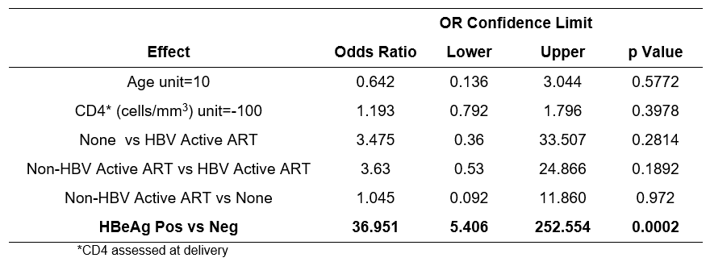
MV Predictors of Maternal High HBV VL status (All- including ART naïve and on ART)
HBeAg-emia Associated with High HBV VL

Slide 45
Maternal HBV DR by Country and ART Status
No HBV Drug Resistance in ART Naïve Women
17% (2/12) Viremic Women on ART and 5% (2/40) of all Women on ART had HBV Drug Resistance

Slide 46
Conclusions
HBsAg and HBeAg prevalence vary by geographic region
Importance of HBeAg in predicting both high maternal HBV VL, important for perinatal outcomes and HBV MTCT
No HBV DR in ART naïve HIV/HBV women
Prevalence of maternal HBV Drug Resistance was 5% 3TC in women HBV-active ART
HBV viremia and high HBV VL common despite 3TC active therapy

Slide 47
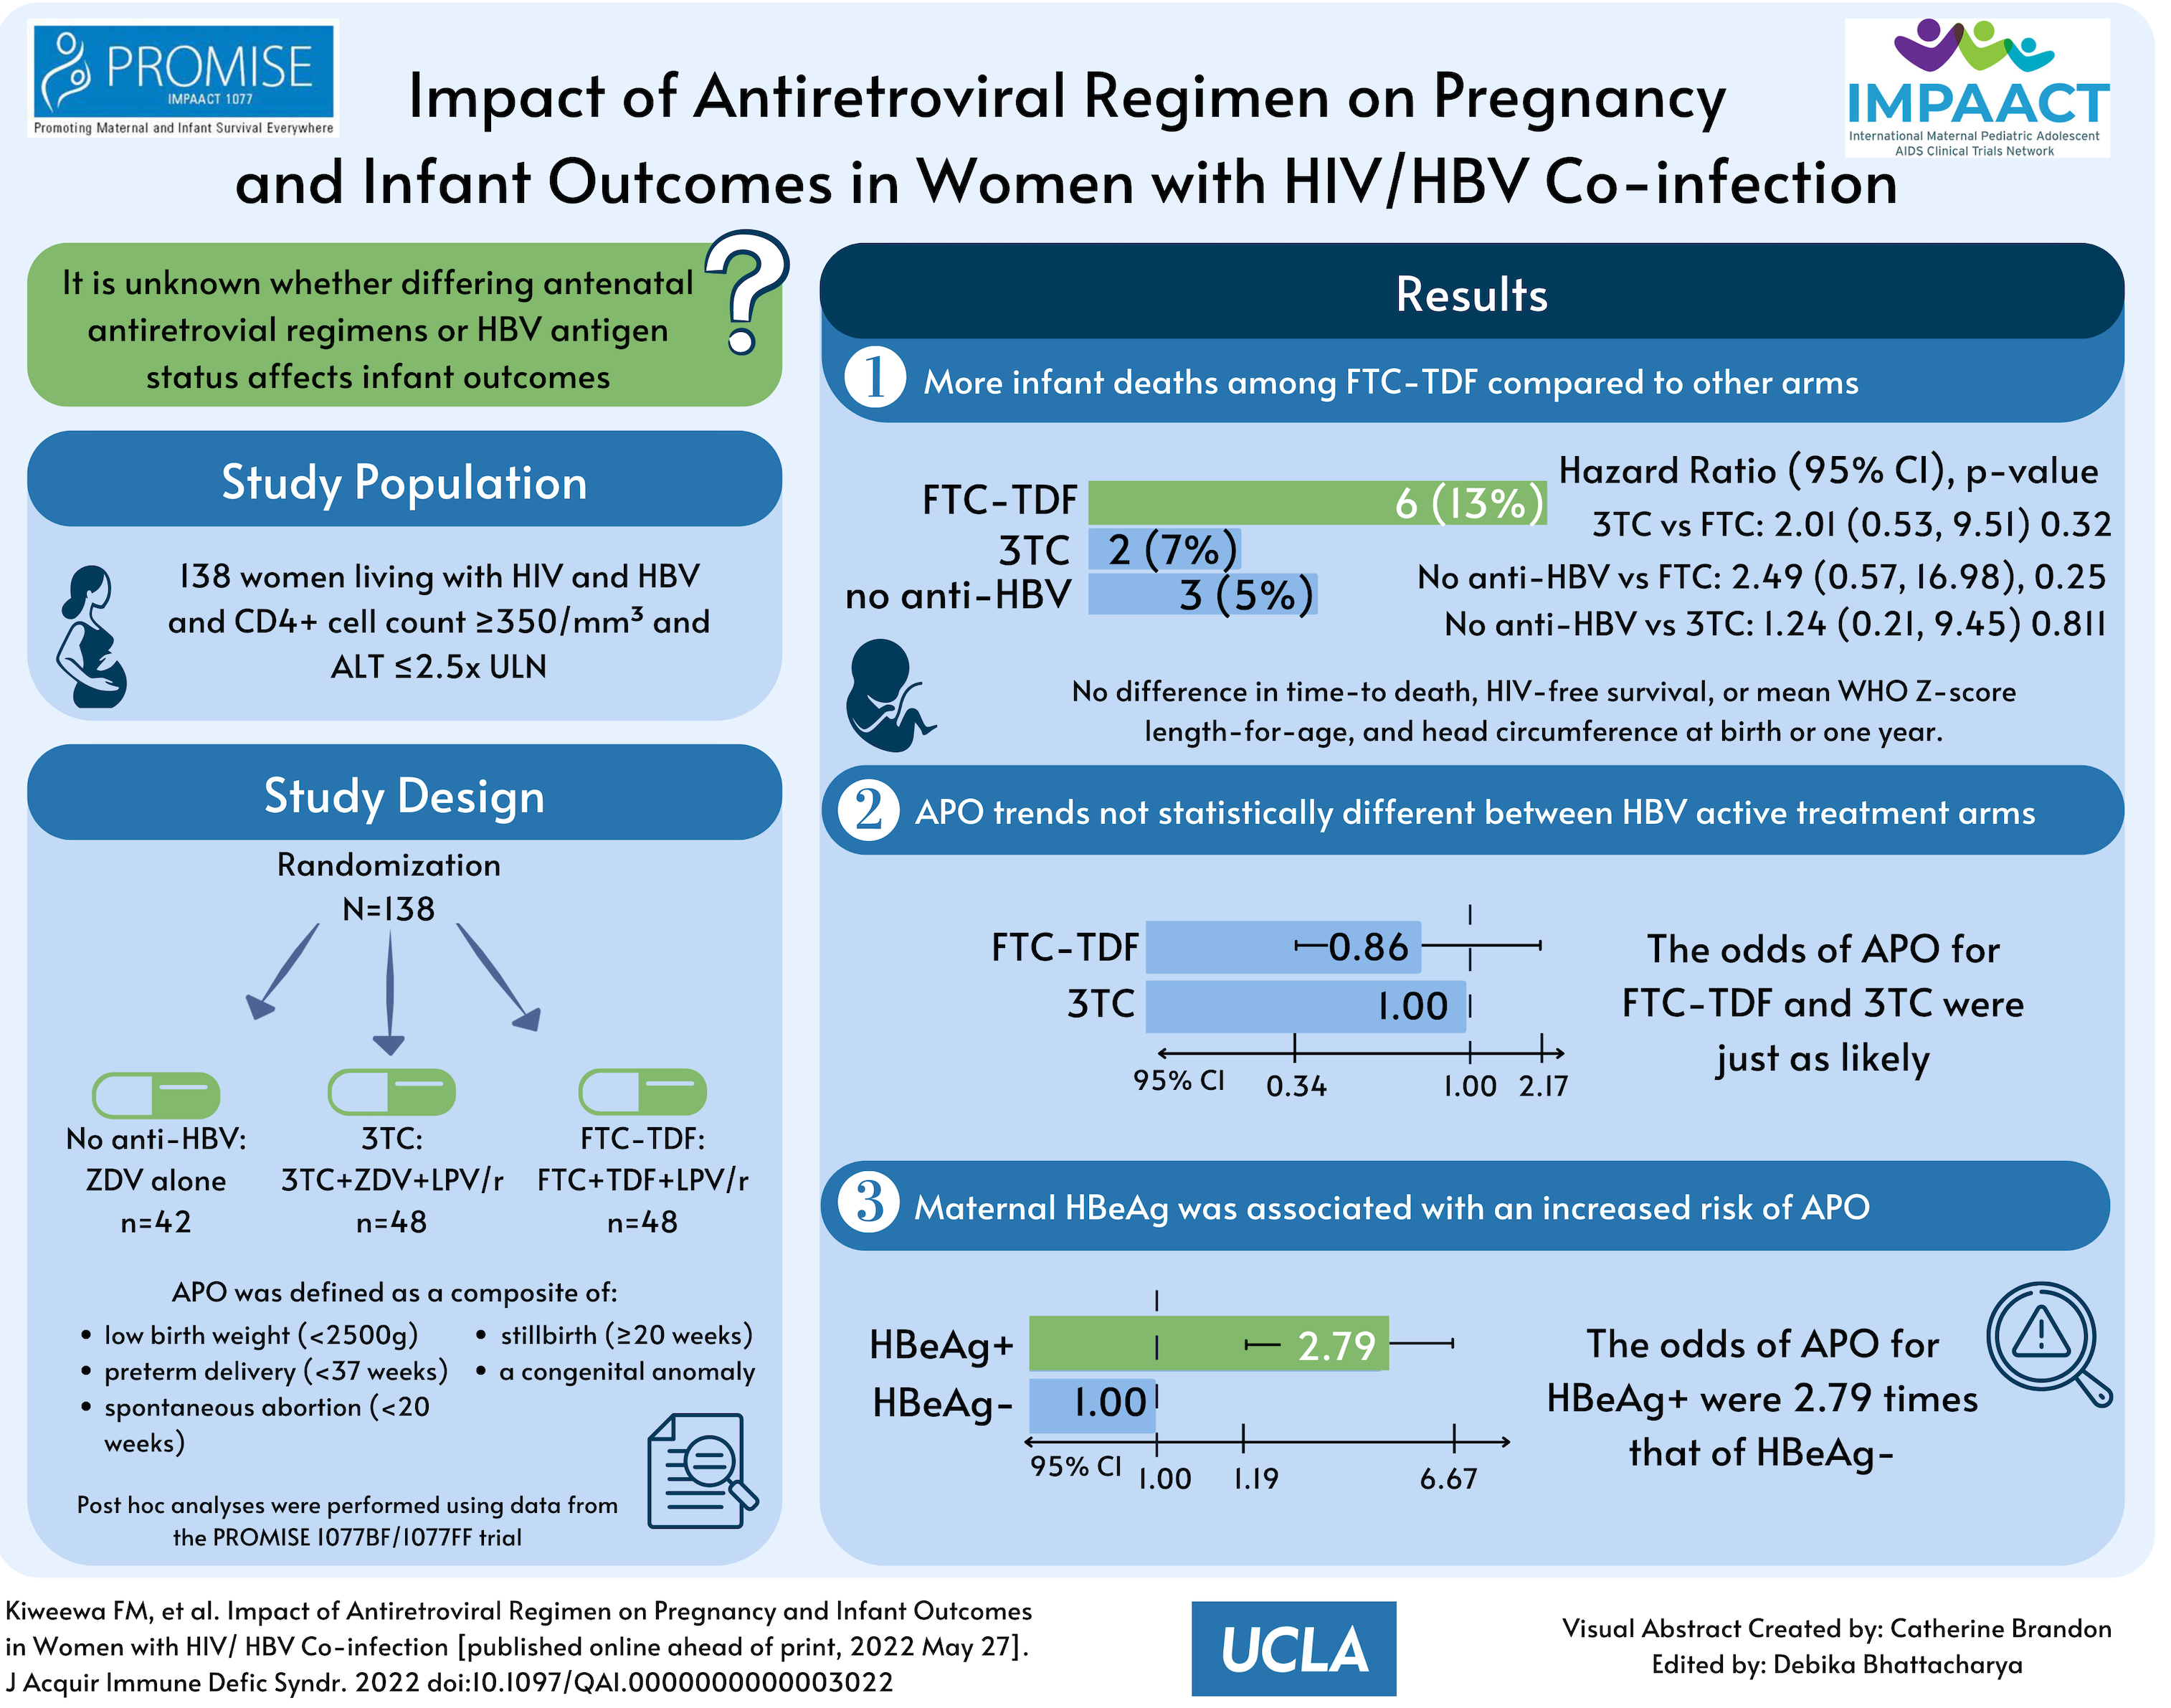

Slide 48
Questions?

Slide 49
Acknowledgments
Organizers (Dr. Kara Chew!)
Participants in HPTN 046 and PROMISE
Funders- NIH- NIAID and NICHD
Mentors:
Dr. Judith Currier
Dr. Yvonne Maldonado
Dr. Marion Peters
Dr. Chloe Thio
Biostatisticians:
Linda Emel
Camlin Tierney
Rong Guo
Chi Hong Tseng
Collaborators
Flavia Matovu Kiweewa
Mary Glenn Fowler
Neaka Mohtashemi

