Slide 1
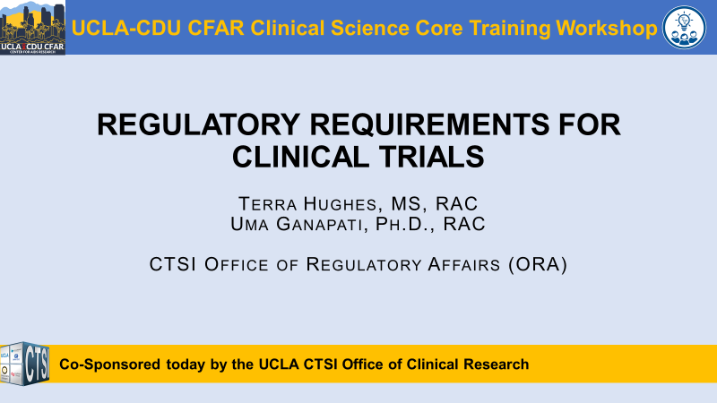

Slide 2
UCLA-CDU CFAR Clinical Science Core Training Workshop Series Objectives
Provide trainings covering the regulatory approval and study implementation aspects of biomedical, behavioral, and basic translational patient-oriented research in HIV
Foster new collaborations
Facilitate referrals to other CFAR and non-CFAR (e.g., CTSI) resources and investigators
UCLA-CDU Center for AIDS Research (CFAR) NIH P30 AI152501

Slide 3

Upcoming Clinical Science Core Events
Monday, 6/26/23, 12-1pm PT: Clinical Discovery Seminar: Medicare data
  Assessing comorbidities and survival in HIV-infected and uninfected matched Medicare enrollees/ accessing Medicare data
  Speaker: Dr. Xiaoying Yu, University of Texas Medical Branch
Monday, 9/18/23, 12-1pm PT: Clinical Discovery Seminar: National NeuroAIDS Tissue Consortium (NNTC)
  Access to ante-mortem and post-mortem data, tissues and biofluids for the neuro HIV research community
  Speaker: Dr. Elyse Singer, UCLA
Thursday, 10/19/23, 12-1pm PT: Training Workshop: How to translate HIV research into policy
  Speaker: Professor Ayako Miyashita Ochoa, UCLA
  Co-sponsored by the Center for HIV Identification, Prevention, and Treatment Services (CHIPTS)
Questions? Contact us at: cfarclinicalcore@mednet.ucla.edu
Core Director: Kara Chew, MD, MS
Core Program Manager: Stephanie Buchbinder, MPH

Slide 4

Office of Clinical Research
Clinical and Translational Science Institute
Regulatory requirements for clinical trials
Terra Hughes, MS, RAC
Uma Ganapati, Ph.D., RAC
CTSI Office of Regulatory Affairs (ORA)

Slide 5
UCLA Clinical and Translational Science Institute
Agenda:
Code of Federal Regulations
Sponsor-Investigator responsibilities in FDA-regulated research
Essential Documents in clinical research
Methods to ensure compliance with Federal regulations
FDA Inspection
CTSI resources to support clinical research

Slide 6
UCLA Clinical and Translational Science Institute
Code of Federal Regulations:
Title 21 of Code of Federal Regulations (CFR)- Food and Drug Administration
      21 CFR Part 50- Protection of Human Subjects
      21 CFR Part 56- Institutional Review Boards
      21 CFR Part 54- Financial Disclosure by Clinical Investigators
      21 CFR Part 11- Electronic Records; Electronic Signatures
      21 CFR Part 312- Investigational New Drug Application
      21 CFR Part 812- Investigational Device Exemption

Slide 7
UCLA Clinical and Translational Science Institute
Sponsor-Investigator Responsibilities
in Clinical Research

Slide 8
Sponsor-Investigator responsibilities in FDA-regulated research
Investigator: An individual who actually conducts a clinical investigation
{21 CFR 312.3 and 21 CFR 812.3}
Sponsor-Investigator: An individual who both initiates and conducts an investigation
A sponsor-investigator’s responsibilities include both those applicable to an investigator and those applicable to a sponsor
{21 CFR 312.3}

Slide 9
Sponsor-Investigator responsibilities in FDA-regulated research
Current Federal law requires that a drug be the subject of an approved marketing application before it is transported or distributed across state lines.
How do you study an investigational drug?
  Seek an exemption from that legal requirement.
  Submit request to FDA for authorization to administer the investigational drug
  This request IS the Investigational New Drug (IND) Application
Notes:
Federal law prohibits the distribution of new drugs or biologics until the FDA has reviewed clinical data and determined that a particular product is safe and effective for a specific use in human subjects.
In order to test a new drug or biologic in clinical trials, it is necessary to obtain an exemption from this law. Thus a drug sponsor is required to apply for an Investigational New Drug (IND) exemption before tests with human subjects may begin.

Slide 10
Forms for IND Submission
FDA Form 1571: SPONSOR-focused
Agreement from sponsor-investigator to conduct research according to appropriate FDA regulations
Cover Sheet for all submissions to the FDA
Form 1572: INVESTIGATOR-focused
Provides sponsor with Investigator qualifications and information about clinical site..
Obligations of investigator and commitment to follow pertinent FDA regulations.
Form 3674
Certifies study is registered in the national database of clinical trials, ClinicalTrials.gov

Slide 11
Overview of Sponsor-Investigator Responsibilities
Select qualified investigators
Provide information needed to conduct trial
Ensure investigation is conducted in accordance with investigational plan
Ensure proper monitoring
Follow regulatory requirements for the IND
Ensure FDA and all participating investigators are promptly informed
of significant new adverse effects risks [21 CFR 312.50] [21 CFR 812.40]

Slide 12
UCLA Clinical and Translational Science Institute
Essential Documents in Clinical Research

Slide 13
Essential Documents in Clinical Research
Regulatory Documents
Individual Participant records
Benefits of maintaining Essential documents:
Compliance with institutional policies, standards of GCP, and all applicable regulatory requirements
Easy to reference research information by study team
Allows review/audit by monitor, auditor, IRB or other regulatory authorities

Slide 14
Essential Documents: Regulatory
Delegation of Authority log (DOA)
Form FDA 1572
Form FDA 1571 (IND application)
Form 3674
IDE application (for certain device studies)
Clinical Investigator Brochure (IB)
IRB approved protocol (all versions) with signed investigator page
Institutional Review Board (21 CFR Part 56)
  IRB membership roster
  IRB correspondence
    Initial IRB approval, continuations, amendments
    IRB approved consent forms
    Post approval reports (PARs)
Scientific review committee correspondence
Data and Safety monitoring Board correspondence
  Initial approval
  Summary reports/approvals
  SAE reports
Sponsor correspondence
FDA correspondence
  Regulatory approval or authorization
  FDA correspondence log
Financial Disclosure forms (21 CFR Part 54)
  Form FDA 3454 and 3455
Investigator qualifications
  CVs (Updated every 2 years)
  Medical licenses (for all physician investigators)
Documentation of training
  HIPAA
  CITI
  Protocol training log for all IRB approved versions
  Any additional sponsor required training
Laboratory certifications
  CLIA
  Lab license
  CAP if applicable
Lab normal ranges (updated every 3 years)
Monitor visit reports
Monitor visit correspondence
Other institutional approval notices
  MRSC, IBC
Blank Case report forms
Logs
  Log of Protocol changes
  Log of Consent form versions
  Screening log
  Subject Enrollment log
  Deviation log
  Specimen tracking log
  Lab specimen shipment log
  Serious Adverse event log
  Monitor visit log
Miscellaneous documents

Slide 15
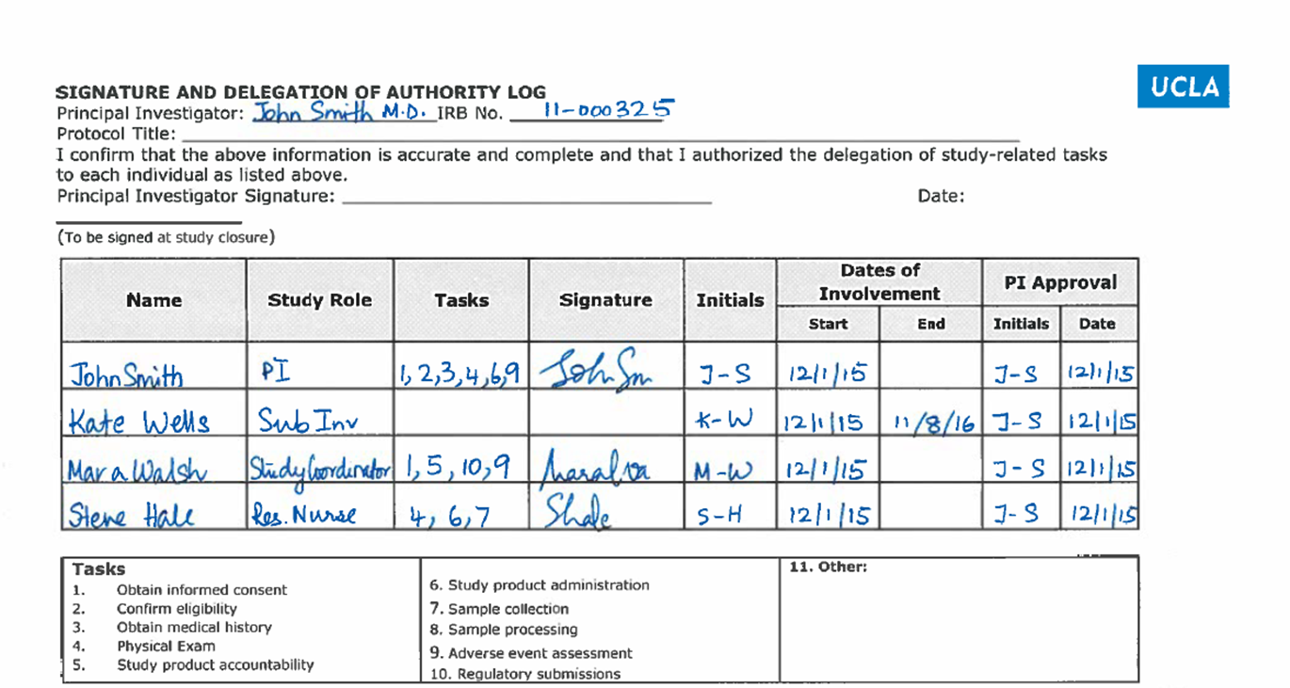

Slide 16
Essential Documents: Individual Participant Records
Source documentation: hospital records, notes, diaries, checklists, labs, X-rays, EKG, Pathology reports, etc.
Signed and dated current IRB approved informed consent/ HIPAA form.
Signed and dated reconsent form
Signed Assent form/youth Assent
Documentation of consent/Assent process/reconsent
Eligibility checklist
Drug accountability for oral drugs (IDAR)
Adverse event log
Concomitant medications log
Serious adverse event form
Coordinator notes for follow up visits

Slide 17
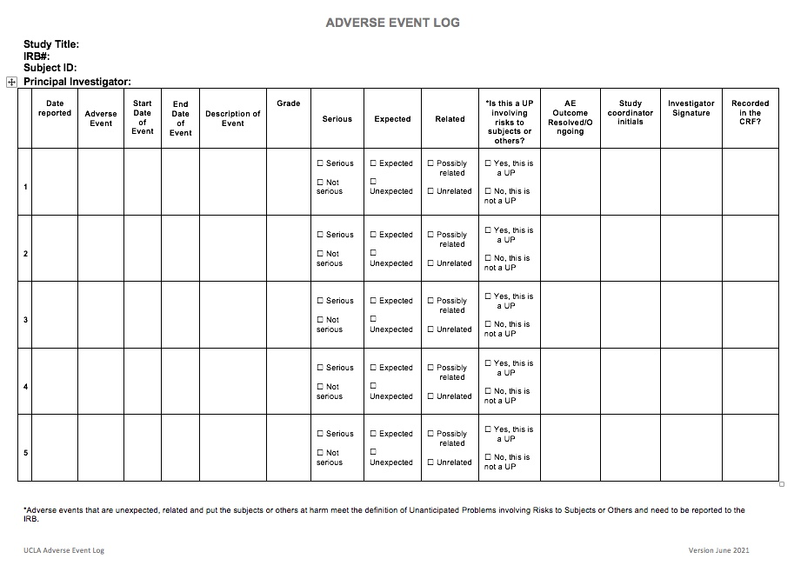

Slide 18
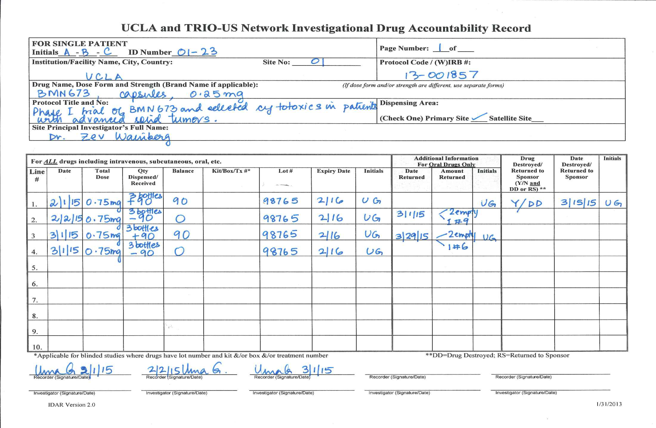

Slide 19
UCLA Clinical and Translational Science Institute
Methods to ensure compliance with Federal regulations

Slide 20
Methods to ensure compliance with Federal Regulations: Monitoring Clinical Trials
NIH Policy for Data and Safety Monitoring
System for appropriate oversight and monitoring of the conduct of clinical trials
FDA guidance
Sponsors can use a variety of approaches
As Sponsor-Investigator, YOU are responsible for
monitoring your own study!

Slide 21
Methods to ensure compliance with Federal Regulations: Monitoring Clinical Trials
Risk based monitoring: focus on critical, data, documents, and processes
Eligibility criteria
Informed consent
Safety
Investigational drug accountability
Regulatory documents (Delegation of authority log (DOA), approval notices from and annual reports to appropriate regulatory agencies)
Timely assessment of adverse events/timely reporting of Serious Adverse Events
Source data verification

Slide 22
Methods to ensure compliance with Federal Regulations: Monitoring Clinical Trials
Common Monitoring and Audit Findings
Patient does not meet eligibility criteria 21 CFR 312.60; 812.100
Failure to meet regulatory requirements for consent 21 CFR 50.20, 50.25, 50.27
Failure to comply with Institutional Review Board (IRB) approval and re-approval guidelines 21 CFR 312.66; 812.62
Failure to properly maintain an FDA IND 21 CFR 312.56 (c)
Inadequate drug accountability records 21 CFR 312.59; 312.62 (a); 812.140
Failure to adequately document/report adverse events 21CFR 312.32, 812.150
Treatment deviation from protocol affecting subject safety 21 CFR 312.60; 812.100

Slide 23
Monitoring and Audit Findings: What to do after?
Respond to queries in monitoring/audit report.
Make necessary corrections
File missing source documents.
Assess root cause
Establish CAPA
Update policies and procedures to avoid repetition of issues

Slide 24
Methods to ensure compliance with Federal Regulations: Good Documentation Practices
ALCOA-C
A- Attributable
L- Legible
C- Contemporaneous
O- Original
A- Accurate
C- Complete
CCEA (Complete, Consistent, Enduring, and Available when needed)
IF IT IS NOT DOCUMENTED, IT DID NOT HAPPEN!

Slide 25
Good Documentation Practices: ALCOA-C
Attributable
who created record and when
Who changed the records; when and why
Legible
Can the data be easily read?
Contemporaneous
Are the data documented in real time?
Original
Study records should be originals or certified copies
Accurate
Study records should give a full account of the research process, be thorough and correct
Complete
Investigators and institutions should maintain adequate, consistent and complete source documents

Slide 26
UCLA Clinical and Translational Science Institute
FDA Inspection

Slide 27
FDA Inspection
BIMO Program: Protection of the rights, safety, and welfare of human research subjects involved in FDA-regulated clinical trials, to verify the accuracy and reliability of clinical trial data submitted to FDA in support of research or marketing applications, and to assess compliance with statutory requirements and FDA's regulations governing the conduct of clinical trials.

Slide 28
FDA Inspection: FDA conducts both announced and unannounced inspections of clinical investigator sites
Notification:
Routine visit: Notification via a phone call, 1-3 days prior to actual visit
When is inspection likely to be scheduled?
An application by the manufacturer: New Drug Application (NDA) or Premarket approval (PMA) for devices.
If evidence of research misconduct has been reported (for cause audit)
What increases chances for a site to be selected for an inspection?
Number of studies per site/PI
High Enrollment
Time since last inspection
Protocol Violations
Serious Adverse Events (SAE)
Percentage of subject deaths
What will be Inspected?
Source data vs Case report forms vs Data submitted for New drug application or premarket approval (PMA for devices)
FDA Verifies PI Supervision and Oversight and Control of all aspects of study including:
Investigator delegation of duties to appropriately qualified personnel
Qualification and training of staff
Medical care of the subject
Day-to-day supervision and oversight: subject care, staff, execution of the protocol

Slide 29
FDA Inspection: What happens after?
Site:
Discuss inspection findings/receive FDA Form 483
Written response to FDA Form 483 within 15 business days
Assess Root cause
Establish corrective and preventive action plan (CAPA)
Re-evaluate action plan periodically
OBIMO:
Complete an Establishment Inspection Report (EIR)
Center:
Review EIR & FDA Form 483 to determine final classification
Send post-inspection letter to site
Communicate inspection findings to premarket review team

Slide 30
Responding to form FDA 483
Form FDA 483 Citation:
You failed to secure investigator compliance with the investigational plan and applicable FDA regulations.
Inadequate Response:
“…virtually all of the serious documentation problems appear to have been the work of a single research coordinator who was delinquent in fulfilling her assigned study duties.”
Adequate response:
Failure to follow the investigational plan
Response: “We have now prepared and adopted a formal written procedure that will help us and our staff to assure compliance with written study protocols and the obligations we accept as clinical investigators for FDA-regulated trials. A copy of the approved SOP is attached. We have reviewed this new procedure at a meeting held on with all research staff (attendance sign-in sheet attached). After 3-6 months, this corrective action will be evaluated for effectiveness.”

Slide 31
FDA Inspection: Top Ten Sponsor-Investigator Citations
Investigation was not conducted in accordance with the investigational plan 312.60; 812.100
Failure to prepare or maintain adequate case histories 312.62 (b); 812.140
Proper monitoring was not ensured 312.50; 812.40
Inadequate IP accountability 312.59; 312.62 (a); 812.140
Failure to assure an IRB was responsible for initial and continuing review and approval of a clinical study 312.66; 812.62
Not all changes in research activity were approved by an Institutional Review Board prior to implementation 312.66; 812.62
Failure to obtain a complete investigator statement, Form FDA 1572, before permitting an investigator to participate in an investigation 312.53 (c) (1)
Failure to get IND/IDE 312.20 (a); 812.40
Failure to submit annual reports to FDA 312.56 (c)
Failure to obtain informed consent in accordance with 21 CFR Part 50 from each human subject prior to drug administration and conducting study-related tests 312.60

Slide 32
Sponsor-Investigator Responsibilities in Clinical Research
Key Takeaways
The Investigator (sponsor-Investigator/Principle Investigator) is ultimately responsible for overall conduct of the study
Integrating quality in clinical research: ALCOA-C
IF IT IS NOT DOCUMENTED, IT DID NOT HAPPEN

Slide 33
Additional Resources
Investigational New Drug Applications (INDs) - Determining Whether Human Research Studies Can Be Conducted Without an IND: https://www.fda.gov/regulatory-information/search-fda-guidance-documents/investigational-new-drug-applications-inds-determining-whether-human-research-studies-can-be
Investigational New Drug Applications Prepared and Submitted by Sponsor-Investigators: https://www.fda.gov/regulatory-information/search-fda-guidance-documents/investigational-new-drug-applications-prepared-and-submitted-sponsor-investigators
Frequently Asked Questions – Statement of Investigator (Form FDA 1572): https://www.fda.gov/regulatory-information/search-fda-guidance-documents/frequently-asked-questions-statement-investigator-form-fda-1572
Form FDA 3674 - Certifications To Accompany Drug, Biological Product, and Device Applications/Submissions: https://www.fda.gov/regulatory-information/search-fda-guidance-documents/form-fda-3674-certifications-accompany-drug-biological-product-and-device-applicationssubmissions
Financial Disclosure by clinical Investigators: https://www.fda.gov/regulatory-information/search-fda-guidance-documents/financial-disclosure-clinical-investigators
Oversight of Clinical Investigations — A Risk-Based Approach to Monitoring: https://www.fda.gov/regulatory-information/search-fda-guidance-documents/oversight-clinical-investigations-risk-based-approach-monitoring
FDA Inspections of Clinical Investigators-Guidance For IRBs, Clinical Investigators, and Sponsors: https://www.fda.gov/regulatory-information/search-fda-guidance-documents/fda-inspections-clinical-investigators
Part 11, Electronic records; electronic signatures- https://www.fda.gov/regulatory-information/search-fda-guidance-documents/part-11-electronic-records-electronic-signatures-scope-and-application

Slide 34
UCLA Clinical and Translational Science Institute
CTSI resources to support clinical research

Slide 35
CTSI Resources to Support Clinical Research
Office of Regulatory Affairs (ORA)
Office of FDA Affairs
Director, Marlene Berro
Scientific and feasibility Review (SRC)
Data and Safety Monitoring Board
Quality Assurance Program (monitoring and auditing)
FDA and Sponsor inspection/audit preparation and guidance
ClinicalTrials.gov registration and results reporting assistance
Regulatory Binder preparation
Remote Monitoring provisioning for sponsor monitors
Assistance with protocol writing
FDA IND/IDE guidance and support
Coordinator services & education (CSE)
Director, Sarahmay Sanchez
Study Activation Team
Clinical Research Coordinator Team
Education and Training
Quality & Clinical Research Ombudsmen
Director, Sandra Binder
UCLA ResearchGo:
https://www.researchgo.ucla.edu/
https://www.researchgo.ucla.edu/investigator-support-services

Slide 36
CTSI Resources to Support Clinical Research
Trial Innovation Network (TIN)
Funding
https://ctsi.ucla.edu/funding/pages/
The Trial Innovation Network (TIN) provides support to investigators conducting or looking to initiate multi-site clinical trials and studies. By working with the UCLA CTSI TIN Liaison, CTSI’s partner sites (including UCLA, Cedars-Sinai, Charles R. Drew University, and Lundquist/Harbor-UCLA) can gain the additional support they need to successfully conduct multi-site studies.
https://ctsi.ucla.edu/researcher-resources/pages/tin
Grant Support
Funding Opportunities
Templates
Clinical Translational Research Center (CTRC)
UCLA Medical Director, Noah Federman, MD
Biostatistical Support
Provides integrated services and biostatistical support
Contemporary data analysis methodology consultation,
implementation, and epidemiology expertise
The best available clinical data management software
Study design assistance
Bioinformatics/computational biology data analysis
Notes:
UCLA CTSI partners, Cedars-Sinai, Charles R. Drew University, Lundquist/Harbor-UCLA and UCLA, each have a CTRC. The four sites have a synchronized IRB approval process with one application for all sites, standard research procedures and mobile research units (off-site services).

Slide 37
USC CTSI Resource
Clinical Trial Quality Training Series- open-access, self-study modules that train academic researchers in essential concepts and practical approaches to monitoring and auditing clinical studies. The module series addresses the need for quality management across the clinical trial lifecycle as stated in the latest addendum to ICH Guideline for Good Clinical Practice (GCP), E6(R2).
  Clinical Trial Quality Training Series | SC CTSI (sc-ctsi.org)

Slide 38
UCLA Clinical and Translational Science Institute
Contact Information: CTSI Office of Regulatory Affairs
ctsiora@mednet.ucla.edu
tnhughes@mednet.ucla.edu (Terra Hughes, Director)
uganapati@mednet.ucla.edu (Uma Ganapati, Associate Director)

Slide 39
UCLA Clinical and Translational Science Institute
Questions?

Slide 40
Challenge Questions
Are there differences in FDA regulatory expectations for industry-sponsored trials as compared to sponsor-investigator trials?
Yes/No
If you are a sponsor-investigator, do you have to submit a Form FDA 1572?
Yes/No
Is Form FDA 3674 required for a research IND (not intended for commercial purposes) and accompanying clinical trial?
Yes/No
Who signs and submits form FDA 1571?
Sponsor
Investigator
Sponsor-Investigator
A &C
Only a clinician can be a principal Investigator on a clinical trial:
True or False
Notes:
Form 3674: This applies to INDs and the submissions of new protocols to INDs as well as new drug applications (NDAs) and biologics license applications (BLAs).

Slide 41
Challenge Questions
Which is a responsibility of a sponsor- investigator, name all that apply:
A. Hiring contract research organization staff
B. Informing patients that the drugs are being used for investigational purposes
C. Ensuring initial and continuing review by an IRB
D. Registering and reporting results of applicable clinical trials to ClinicalTrials.gov

Slide 42
Challenge Questions
Which of the following statements are true, name all that apply?
A. S-I are required to report to FDA serious and unexpected adverse events.
B. S-I are required to submit to FDA clinical summary reports of all ongoing trials every 6 months.
C. S-I must permit FDA to have access to and copy and verify any records or reports made for the clinical trial.
D. S-I is responsible for monitoring their own study.

Slide 43
Challenge Question
Which of the following study types require the clinical investigator to sign a Form FDA 1572, Statement of Investigator?
A. Drugs
B. Devices
C. Biologics
D. A & C

Slide 44
Challenge Question
Which of the following responsibilities can be delegated to the study coordinator?
  A. Study drug accountability
  B. Physical exam
  C. Regulatory submissions
  D. A & C

